Slide 1
Networks

Slide 2
Graphs: Koenigsberg bridges
Leonard Euler problem (1736)

Slide 3
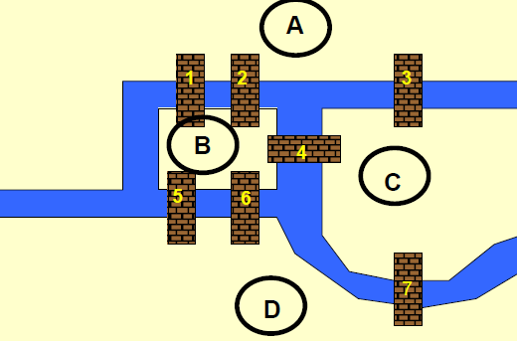
Nodes

Slide 4
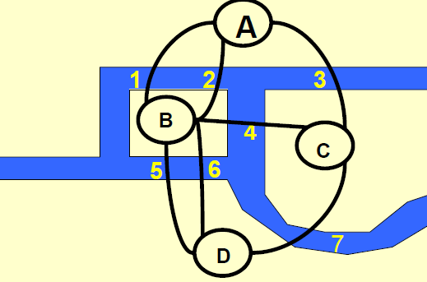
Edges

Slide 5
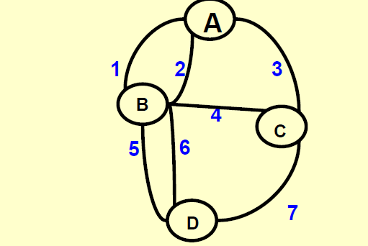
Is there a walk which uses each edge exactly once?

Slide 6
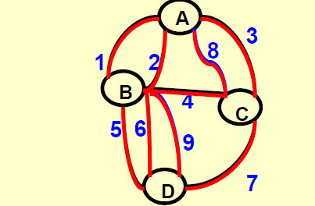
Build two more bridges.

Slide 7
Each such walk has to enter and leave any given node. The degree of any node has to be even.

Slide 8
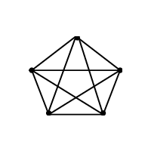
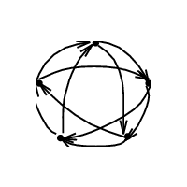
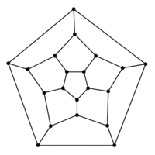
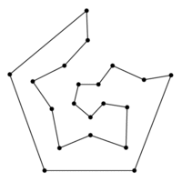
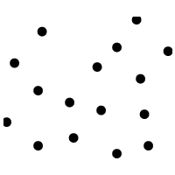
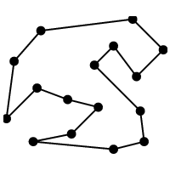
Eulerian cycle
Hamiltonian cycle
Travelling salesman problem

Slide 9
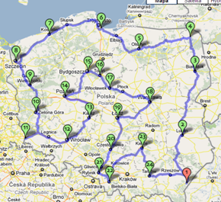
TSP - cycle
Duration:
2 d 7 h 2 m Length:
3615 km

Slide 10
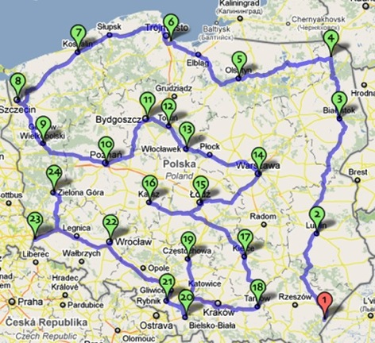
TSP - trail
Duration:
2 d 4 h 37 m
Length:
3436 km

Slide 11
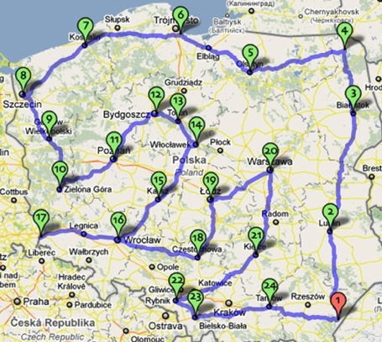
TSP – a real walk
Duration:
29 d 11 h 21 m Length:
3485 km

Slide 12
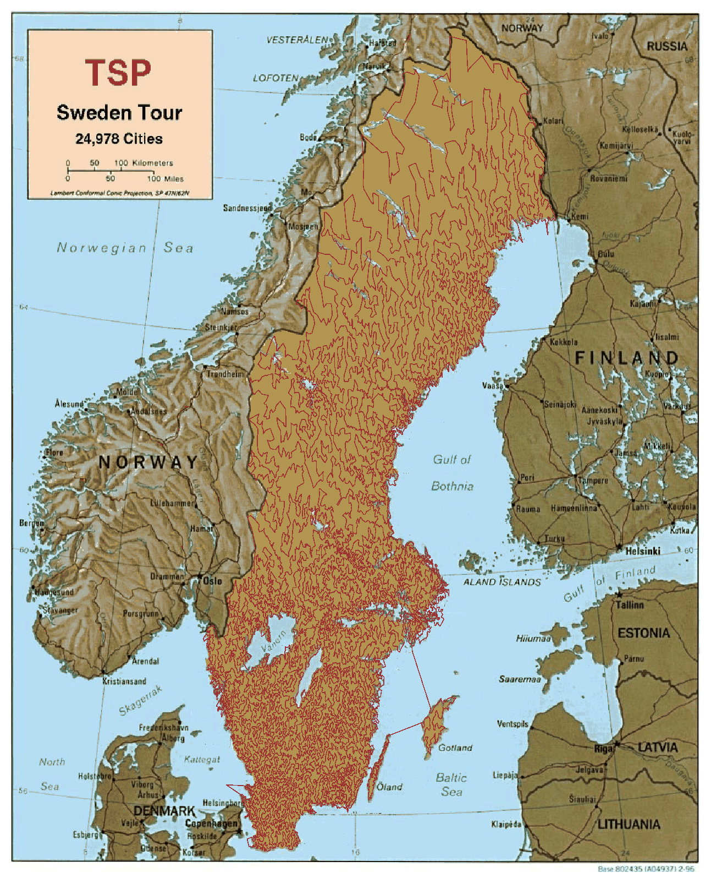

Slide 13
Travelling salesman problem TSP
Mathematically
Variable x_{ij} = 1, if the salesman passes from i to j, 0 otherwise
Going from one city to the same city is forbidden
Is this all ???

Slide 14
TSP
Is this all?
Let’s say our solution with 5 cities is x₁₂=x₂₃=x₃₁=x₄₅=x₅₄=1
It satisfies all the constraints. But it involves subtours (cycles involving fewer than all cities)
We need to introduce additional constraints

Slide 15
Subtour elimination
For two cities
For three cities
For four cities
Etc.
In practical implementation too many constraints: with 30 cities there would be 870 constraints eliminating only subtours of length 2

Slide 16
Subtour eleimination – second approach
Introduce nonnegative variables u_{i}:
Subtours are eliminated
How many such constraints?
(N-1)²-N, i.e. with 30 cities there would be 812 constraints.

Slide 17
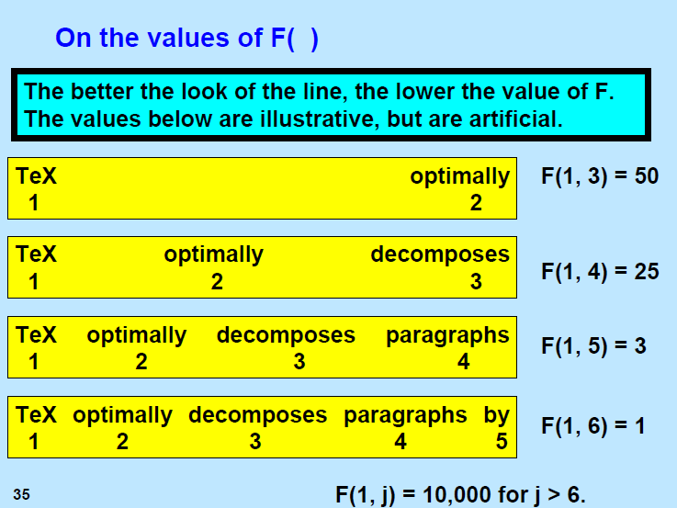

Slide 18
Game
http://www.tsp.gatech.edu/games/index.html

