Slide 1
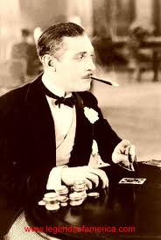
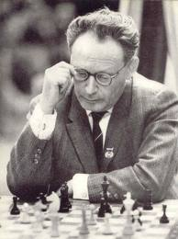
Individual decision theory vs game theory

Slide 2
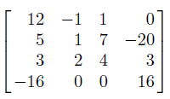
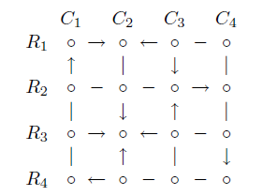
Zero-sum games
In zero-sum games, payoffs in each cell sum up to zero
Movement diagram

Slide 3
Zero-sum games
Minimax = maximin = value of the game
The game may have multiple saddle points

Slide 4
Zero-sum games
Or it may have no saddle points
To find the value of such game, consider mixed strategies

Slide 5
Zero-sum games
If there is more strategies, you don’t know which one will be part of optimal mixed strategy.
Let Column mixed strategy be (x,1-x)
Then Raw will try to maximize

Slide 6
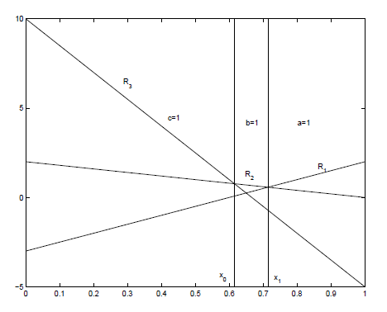
Zero-sum games
Column will try to choose x to minimize the upper envelope

Slide 7
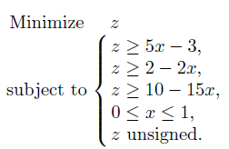
Zero-sum games
Tranform into Linear Programming

Slide 8
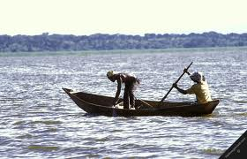
Fishing on Jamaica
In the fifties, Davenport studied a village of 200 people on the south shore of Jamaica, whose inhabitants made their living by fishing.

Slide 9
Twenty-six fishing crews in sailing, dugout canoes fish this area [fishing grounds extend outward from shore about 22 miles] by setting fish pots, which are drawn and reset, weather and sea permitting, on three regular fishing days each week … The fishing grounds are divided into inside and outside banks. The inside banks lie from 5-15 miles offshore, while the outside banks all lie beyond … Because of special underwater contours and the location of one prominent headland, very strong currents set across the outside banks at frequent intervals … These currents are not related in any apparent way to weather and sea conditions of the local region. The inside banks are almost fully protected from the currents. [Davenport 1960]

Slide 10
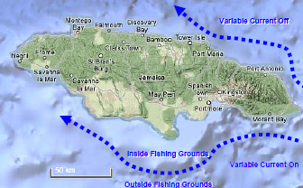
Jamaica on a map

Slide 11
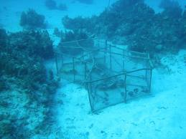
Strategies
There were 26 wooden canoes. The captains of the canoes might adopt 3 fishing strategies:
IN – put all pots on the inside banks
OUT – put all pots on the outside banks
IN-OUT) – put some pots on the inside banks, some pots on the outside

Slide 12
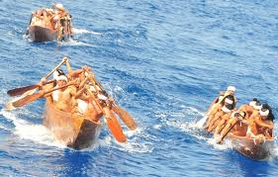
Advantages and disadvantages of fishing in the open sea
Disadvantages
It takes more time to reach, so fewers pots can be set
When the current is running, it is harmful to outside pots
marks are dragged away
pots may be smashed while moving
changes in temeperature may kill fish inside the pots
Advanatages
The outside banks produce higher quality fish both in variaties and in size.
If many outside fish are available, they may drive the inside fish off the market.
The OUT and IN-OUT strategies require better canoes.
Their captains dominate the sport of canoe racing, which is prestigious and offers large rewards.

Slide 13
Collecting data
Davenport collected the data concerning the fishermen average monthly profit depending on the fishing strategies they used to adopt.
Fishermen\Current | FLOW | NO FLOW
IN | 17,3 | 11,5
OUT | -4,4 | 20,6
IN-OUT | 5,2 | 17,0

Slide 14
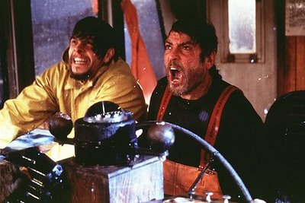
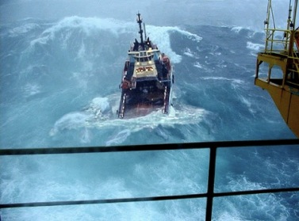
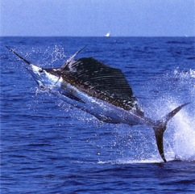
OUT Strategy

Slide 15
Zero-sum game? The current’s problem
There is no saddle point
Mixed strategy:
Assume that the current is vicious and plays strategy FLOW with probability p, and NO FLOW with probability 1-p
Fishermen’s strategy: IN with prob. q1, OUT with prob. q2, IN-OUT with prob. q3
For every p, fishermen choose q1,q2 and q3 that maximizes:
And the vicious current chooses p, so that the fishermen get min

Slide 16
Graphical solution of the current’s problem
Solution: p=0.31
Mixed strategy of the current

Slide 17
The fishermen’s problem
Similarly:
For every fishermen’s strategy q1,q2 and q3, the vicious current chooses p so that the fishermen earn the least:
The fishermen will try to choose q1,q2 and q3 to maximize their payoff:

Slide 18
Maximin and minimax
 | objective function | Fishers' mixed strategy
 |  | q1 | q2 | q3
Maximize | 13,31 | 0,67 | 0,00 | 0,33
Expected payoff of the current when
FLOW | 13,31 | >= | 13,31
NO FLOW | 13,31 | >= | 13,31
probabilities | 1,00 | = | 1,00
Optimal strategy for the fishermen
Value of the game
Optimal strategy for the current
 | objective function | Mixed strategy of the current
 |  | p | 1-p
minimize | 13,31 | 0,31 | 0,69
Expected payoff from strategy:
IN | 13,31 | <= | 13,31
OUT | 12,79 | <= | 13,31
IN_OUT | 13,31 | <= | 13,31
probabilities | 1,00 | = | 1,00

Slide 19
Minimax sensitivity report
Microsoft Excel 12.0 Raport wrażliwości
Arkusz: [jamajka.xlsx]minimax
Raport utworzony: 2013-03-27 16:24:55
Komórki decyzyjne
 |  |  | Wartość | Przyrost | Współczynnik | Dopuszczalny | Dopuszczalny
 | Komórka | Nazwa | końcowa | krańcowy | funkcji celu | wzrost | spadek
 | $C$3 | objective function | 13,31 | 0,00 | 1 | 1E+30 | 1
 | $D$3 | p | 0,31 | 0,00 | 0 | 11,8 | 5,8
 | $E$3 | 1-p | 0,69 | 0,00 | 0 | 5,8 | 11,8
Warunki ograniczające
 |  |  | Wartość | Cena | Prawa strona | Dopuszczalny | Dopuszczalny
 | Komórka | Nazwa | końcowa | dualna | w. o. | wzrost | spadek
 | $B$6 | IN | 13,31 | -0,67 | 0 | 12,1 | 0,7
 | $B$7 | OUT | 12,79 | 0,00 | 0 | 1E+30 | 0,525
 | $B$8 | IN-OUT | 13,31 | -0,33 | 0 | 0,3 | 12,1
 | $B$9 | probabilities | 1,00 | 13,31 | 1 | 1E+30 | 1

Slide 20
Maximin sensitivity report
Microsoft Excel 12.0 Raport wrażliwości
Arkusz: [jamajka.xlsx]maximin
Raport utworzony: 2013-03-27 16:23:31
Komórki decyzyjne
 |  |  | Wartość | Przyrost | Współczynnik | Dopuszczalny | Dopuszczalny
 | Komórka | Nazwa | końcowa | krańcowy | funkcji celu | wzrost | spadek
 | $C$3 | objective function | 13,31 | 0,00 | 1 | 1E+30 | 1
 | $D$3 | q1 | 0,67 | 0,00 | 0 | 0,7 | 12,1
 | $E$3 | q2 | 0,00 | -0,52 | 0 | 0,525 | 1E+30
 | $F$3 | q3 | 0,33 | 0,00 | 0 | 12,1 | 0,3
Warunki ograniczające
 |  |  | Wartość | Cena | Prawa strona | Dopuszczalny | Dopuszczalny
 | Komórka | Nazwa | końcowa | dualna | w. o. | wzrost | spadek
 | $B$6 | FLOW | 13,31 | -0,31 | 0 | 5,8 | 11,8
 | $B$7 | NO FLOW | 13,31 | -0,69 | 0 | 11,8 | 5,8
 | $B$8 | probabilities | 1,00 | 13,31 | 1 | 1E+30 | 1

Slide 21
Forecast and observation
Game theory predicts
Observation shows
No fishermen risks fishing outside
Strategy 67% IN, 33% IN-OUT [Payoff: 13.31]
Optimal current’s strategy 31% FLOW, 69% NO FLOW
No fishermen risks fishing outside
Strategy 69% IN, 31% IN-OUT [Payoff: 13.38]
Current’s „strategy”: 25% FLOW, 75% NO FLOW
The similarity is striking
Davenport’s finding went unchallenged for several years
Until …

Slide 22
Current is not vicious
Kozelka 1969 and Read, Read 1970 pointed out a serious flaw:
The current is not a reasoning entity and cannot adjust to fishermen changing their strategies.
Hence fishermen should use Expected Value principle:
Expected payoff of the fishermen:
IN: 0.25 x 17.3 + 0.75 x 11.5 = 12.95
OUT: 0.25 x (-4.4) + 0.75 x 20.6 = 14.35
IN-OUT: 0.25 x 5.2 + 0.75 x 17.0 = 14.05
Hence, all of the fishermen should fish OUTside.
Maybe, they are not well adapted after all
Fishermen\Current | FLOW (25%) | NO FLOW (75%)
IN | 17,3 | 11,5
OUT | -4,4 | 20,6
IN-OUT | 5,2 | 17,0

Slide 23
Current may be vicious after all
The current does not reason, but it is very risky to fish outside.
Even if the current runs 25% of the time ON AVERAGE, it might run considerably more or less in the short run of a year.
Suppose one year it ran 35% of the time. Expected payoffs:
IN: 0.35 x 17.3 + 0.65 x 11.5 = 13.53
OUT: 0.35 x (-4.4) + 0.65 x 11.5 = 11.85
IN-OUT: 0.35 x 5.2 + 0.65 x 17.0 = 12.87.
By treating the current as their opponent, fishermen GUARANTEE themselves payoff of at least 13.31.
Fishermen pay 1.05 pounds as insurance premium
 | Actual (25%) | Vicious (31%) | 35%
Optimal | 13.3125 | 13.3125 | 13.3125
Actual | 13.291 | 13.31164 | 13.3254
OUT | 14.35 | 12.85 | 11.85

