Slide 1
Operations management
Introduction

Slide 2
Formal stuff
Webpage: http://www.mlewandowski.waw.pl
Contact: michal.lewandowski@sgh.waw.pl
mlewandowski@kozminski.edu.pl
(please use both just in case)
Office hours : after classes (prior notification by e-mail)
Grade policy: 20% case study, 80% exam (need to be verified)
Exam: Excel file with the solutions sent to my e-mail address.

Slide 3
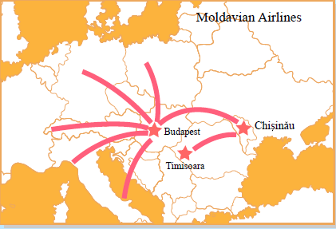
What is Operations Research?
Operations Research or management science
II World War: British military leaders asked scientists and engineers to analyze several military problems:
Deployment of radar
Management of convoy, bombing, antisubmarine, and mining operations.
The result was called Operations Research
Operations Research (O.R.) is the discipline of applying advanced analytical methods to help make better decisions. http://www.scienceofbetter.org/
http://www.orms-today.org/ormsmain.shtml

Slide 4
Operations Research in Practice
Addressing managerial problems: A management science framework
Determine the problem to be solved
Observe the system and gather data
Formulate a mathematical model of the problem and any important subproblems
Verify the model and use the model for prediction or analysis
Select a suitable alternative
Present the results to the organization
Implement and evaluate

Slide 5
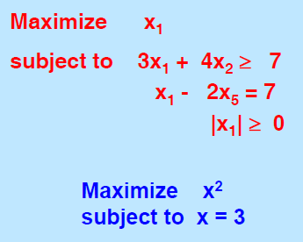
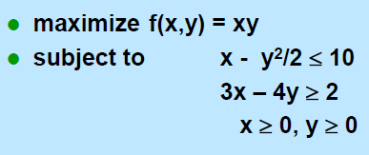
Linear programming (LP)
Minimize or maximize a linear function
The constraints are linear equalities and inequalities
Which of the following are LP problems?

Slide 6
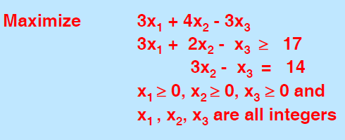
Integer program
An integer program is a linear program plus constraints that some or all of the variables are integer valued.
Integer programs are much more often encountered in practice. To solve them, we use techniques based on LP problems

Slide 7
Overview
Scheduling Postal Workers (5 in 7)
The model
Practical enhancements or modifications
Two non-linear objectives that can be made linear
A non-linear constraint that can be made linear

Slide 8
Scheduling postal workers
Each postal worker works for 5 consecutive days, followed by 2 days off, repeated weekly.
Demand for workers in each day of the week is the following:
Minimize the number of postal workers (for the time being, we will permit fractional workers on each day.)
Formulate the problem: Identify
decision variables
objective function
constraints
feasible solution
optimal solution, best feasible solution
Day | Mon | Tue | Wed | Thu | Fri | Sat | Sun
Demand | 17 | 13 | 15 | 19 | 14 | 16 | 11

Slide 9
Identifying decision variables
Let’s try: y_{i} – number of people working on day i
Demand constraints are easy
How to formulate constraint „5 days at work followed by 2 days off”?
Impossible

Slide 10
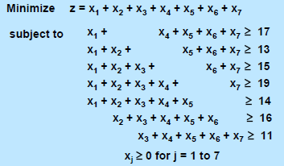
Identifying decision variables
Objective function
MON
TUE
WED
THU
FRI
SAT
SUN
This is a really unusual model in that the constraint of “5 days on followed by 2 days off” is handled by choosing the decision variables carefully.
In particular, the first decision variable is the number of workers who start on Monday and work through Friday.
The next 6 variables are chosen similarly. In this way, any selection of decision variables will automatically satisfy the constraint.
The objective function is just the sum of all decision variables
Constraints

Slide 11
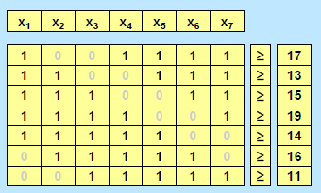
Table
MON
TUE
WED
THU
FRI
SAT
SUN

Slide 12
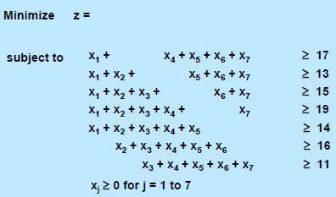
Modification 1
Suppose that there was a pay differential. The cost of workers who start work on day j is cj per worker.
Suppose that one can hire part time workers (one day at a time), and that the cost of a part time worker on day j is pj.
What are the new decision variables? What are the changes to the model?

Slide 13
Another modification
Suppose that the desirable number of workers on day j is dj, but it is not required. Let sj be the “excess” number of workers day j. sj > 0 if there are more workers on day j than dj; otherwise sj ≤ 0.
What is the minimum cost schedule, where the “cost” of having too many workers on day j is fj(sj), which is a non-linear function?
We treat the number of workers on each day as a goal for the day, and penalize not reaching the goal exactly. Having too many workers may be inefficient uses of labor. Having too few workers may make it difficult to handle the tasks for the day.
What are the new decision variables? What is the resulting non-linear model?

Slide 14
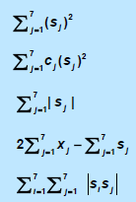
Occasionally a non-linear program can be transformed into a linear program.
Rare, but useful when it occurs
In general, non-linear programming solvers can work well on a minimization problem when the objective function is convex
Examples of nonlinear functions
Sum of squared s’s
Weighted sum of squared s’s
Sum of absolute values of s’s
Twice number of workers minus sum of s’s
Nonseparable function
An objective function is called separable if it can be expressed as the sum of functions of 1 variable .

Slide 15
Which function is convex?

Slide 16
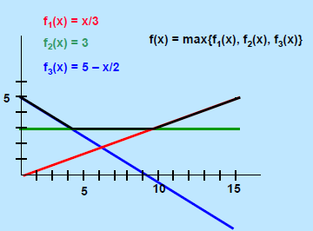
Maximum of several linear functions is convex

Slide 17
Proof
Suppose that f( ) and g( ) are both convex functions.
Let h(x) = max(f(x), g(x)).We will show that h(x) is convex.
Suppose that q ∈ [0, 1]. Let x”= (1-q) x + q x’
Then h(x”) = max {f(x”), g(x”)}
<= max {(1-q) f(x) + q f(x’), (1-q) g(x) + q g(x’)}
<= (1-q) max {f(x), g(x)} + q max {f(x), g(x)}
= (1-q) h(x) + q h(x’),
showing that h(x) is convex.

Slide 18
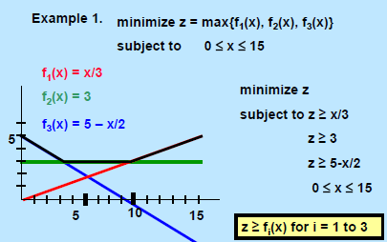
Minimax
We will say that f(x) is a friendly non-linear function if it can be written as the max of one or more linear functions.
If a minimization problem P* has a friendly objective function its feasible region is that of an LP, then P* can be expressed as a linear program.
On minimizing friendly objective functuions:
Problem with a friendly function
LP problem

Slide 19
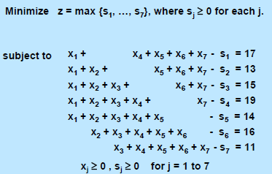
Back to scheduling postal workers
minimize the maximum number of excess workers needed on any day: that is

Slide 20
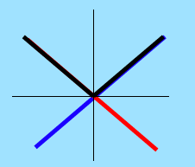
Another example of friendly objective function
Suppose the objective is minimize |s1| + … + |s7|. How do we modify it to make it linear?
Key observation: Note: |sj| = max{sj, -sj} for each j.
We create a new variable z^{j} for each term in the sum.
So, the objective function becomes
Minimize z¹+ z²+ …+ z⁷
Additional constraints:
z¹>= s¹, z¹>= -s¹
z²>= s², z²>= -s²
…
z⁷>= s⁷, z⁷>= -s⁷
In any optimal solution, it will be true that z^{j} = |s^{j}| for j = 1 to 7.

Slide 21
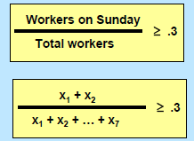
A ratio constraint: another non-linear constraint that can be made linear
Suppose that we need to ensure that at least 30% of the workers have Sunday off. How do we model this?
But this constraint is nonlinear

Slide 22
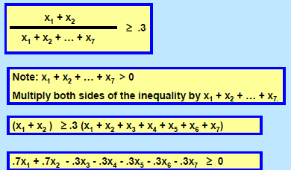
Making it linear

Slide 23
Other enhancements
Require that each shift has an integral number of workers
integer program
Consider longer term scheduling
model 6 weeks at a time
Consider shorter term scheduling
model lunch breaks
Model individual workers
permit worker preferences

Slide 24
Simple optimization problem
You are given a set of numbers. Divide them into two subsets such that the sum of numbers in each subset was as small as possible
Example: 7, 10, 13, 17, 20, 22
You can divide them into {20,22} (sum 42) and {7, 10, 13, 17} (sum 47)
The difference in sums equals 5
Can we do better?

